Slide 1
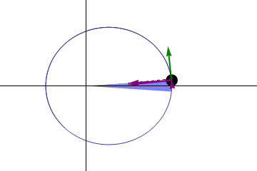
Kepler’s second law
The same (blue) area is swept out in a fixed time period. The green arrow is velocity. The purple arrow directed towards the Sun is the acceleration. The other two purple arrows are acceleration components parallel and perpendicular to the velocity.

Slide 2
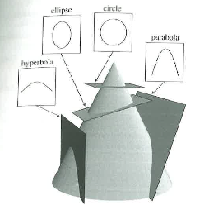

Slide 3
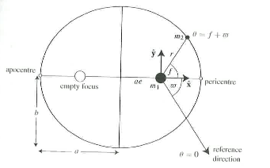

Slide 4
y
c=ae
r
𝜃
x
b
a

